Slide 1
Inside Tent 1
Chapel
Trash Cans
Trash Cans
Table w/ 10 chairs
Table w/ 10 chairs
Table w/ 10 chairs
Student Center
Buffet
Buffet
Buffet
PIG Roast CO.
Side Walk

Slide 2
Inside Tent 2
Chapel
Table w/ 10 chairs
Table w/ 10 chairs
Table w/ 10 chairs
Trash Cans
Emillie Hall
Student Center / Tent 1
Trash Cans
Side Walk

Slide 3
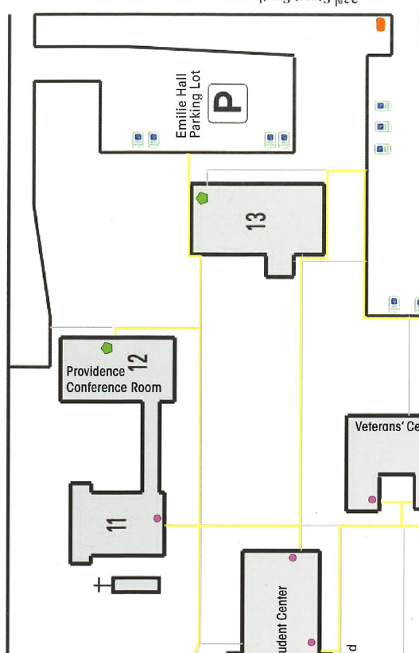
Birds Eye View
National Guard Blow UP Obstacle
Tent 1
Dance Floor
Tent 2
DJ/ SARGE

